Slide 1

GEM Advanced Magnetometers
Company Presentation
Taiwan, 2012
Michael Wilson
Director, Production
www.gemsys.ca
mike.wilson@gemsys.ca

Slide 2


GEM Systems Inc.
World leader in develop and produce geophysical equipment for mineral exploration, focused exclusively on magnetic technologies (scalar quantum systems)
The company has been created in 1980
The headquarter and production line are located in Ontario, Canada
We have a wide net of distributors
of our equipment all over the world
Notes:
2

Slide 3
GEM Systems Success
Development of top technologies with the highest standards of sensitivity and absolute accuracy
Strong Technical and Service support
Customers in more than 100 countries all over the world
Focus on what we do best - develop magnetic instruments only
Continually work to improve based on GEM innovation & customer feedback
Notes:
3

Slide 4
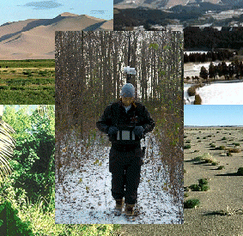
GEM Systems Magnetometers
Applications:
Mineral Exploration (airborne and ground surveys)
Near surface geophysics
UXO
Magnetic Observatories
Earthquake prediction
Volcanology
Archaeology
Scientific research
Notes:
4

Slide 5
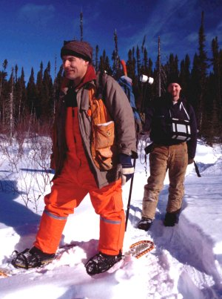
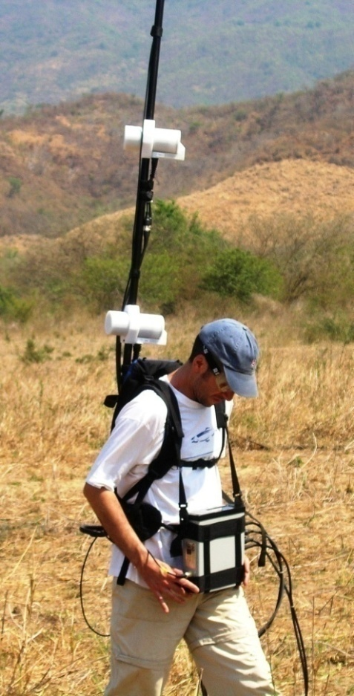
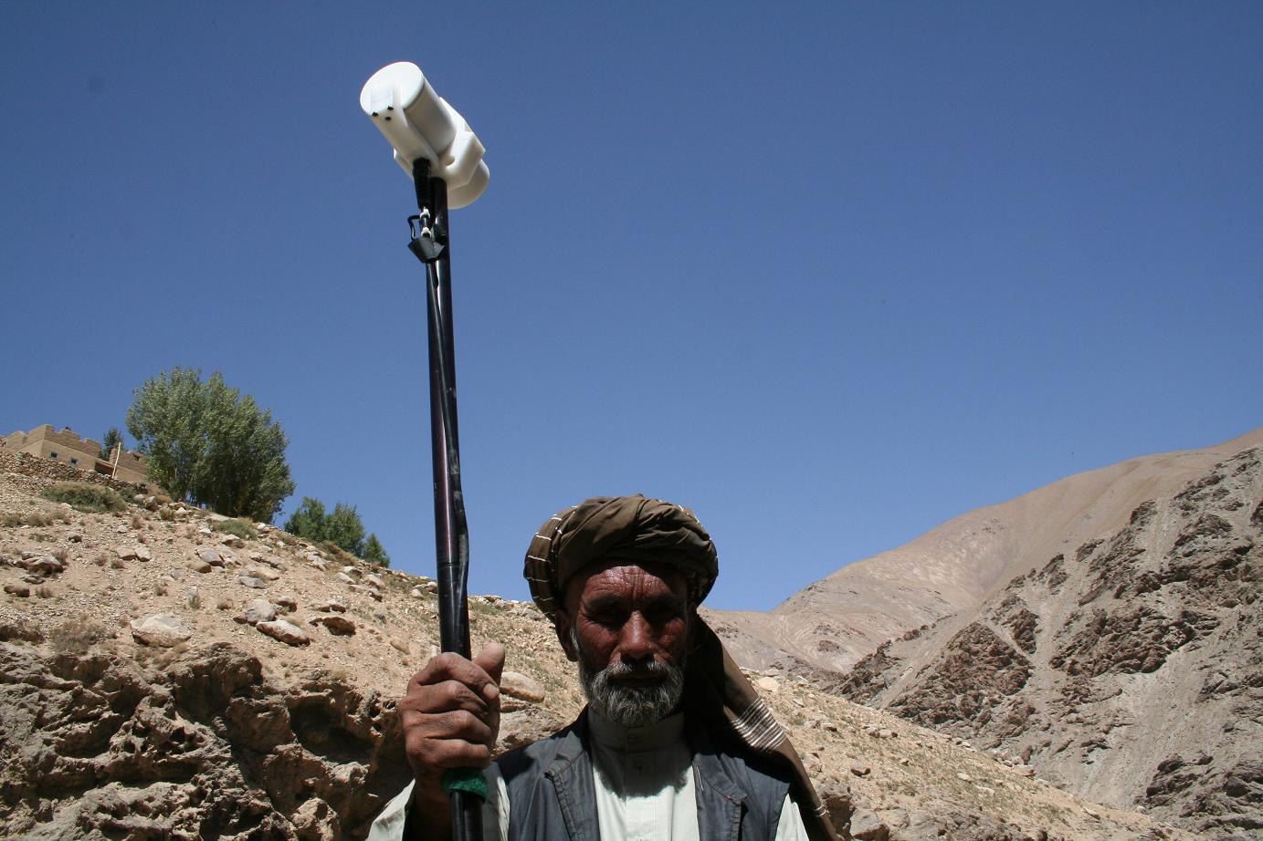
GEM Systems’ Equipment
Mineral Exploration
Courtesy: Jared D. Abraham, USGS
“Quantec Geoscience has used GEM’s advanced magnetometers for many years to assist in the discovery and delineation of economic ore deposits.”
Notes:
5

Slide 6
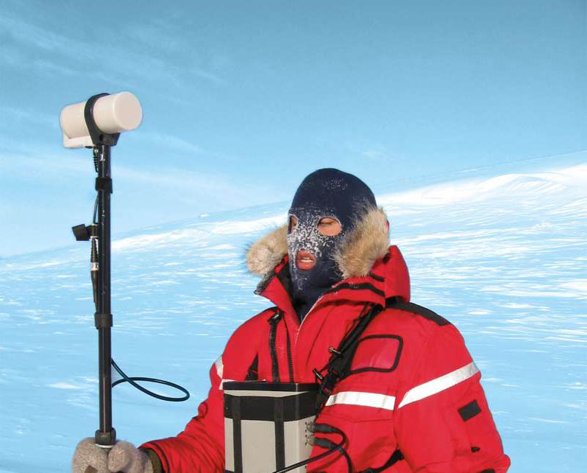
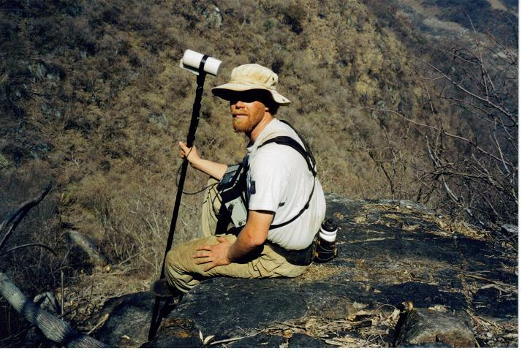
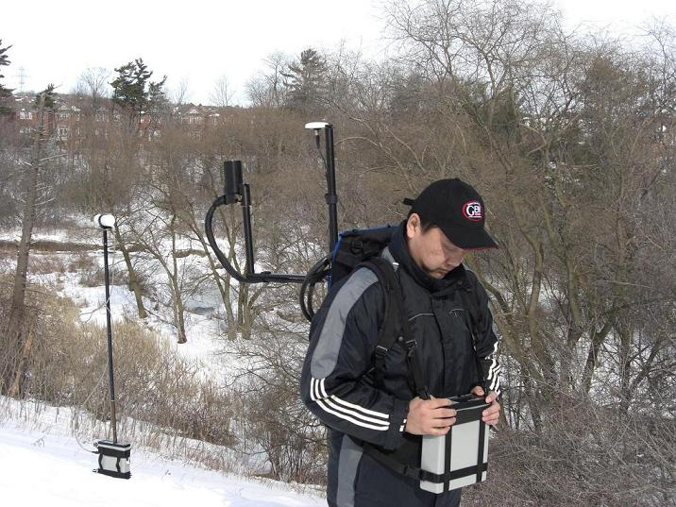
GEM Systems’ Equipment
Near surface geophysics
Notes:
6

Slide 7
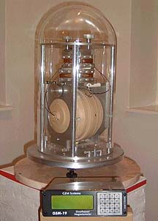
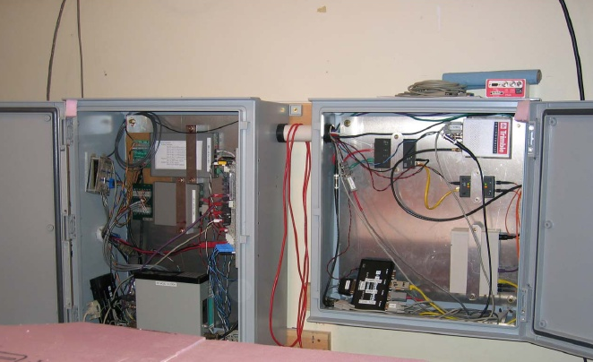

GEM Systems’ Equipment
Magnetic Observatories
“The US Geological Survey uses GEM Systems magnetometers at all of its Magnetic Observatories. We are very happy to have such an accurate, reliable magnetometer”
Alan M Berarducci, USGS.
Notes:
7

Slide 8
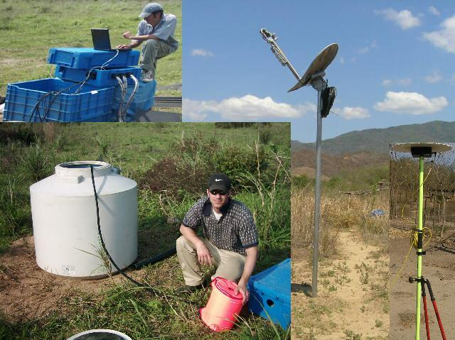
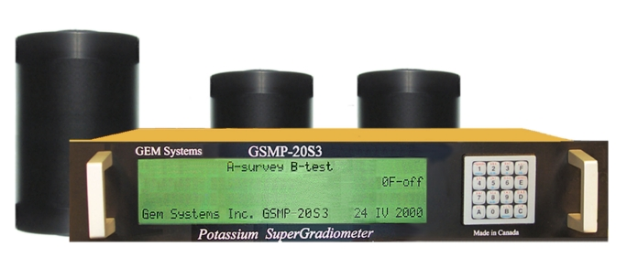
GEM Systems’ Equipment
Earthquake research and natural hazard monitoring
Notes:
8

Slide 9
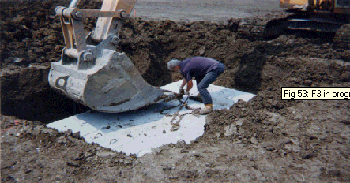
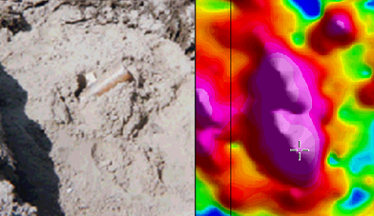
GEM Systems’ Equipment
UXO
Concrete bunker
1,0 m
Artillery shell
0,5 m
Notes:
9

Slide 10
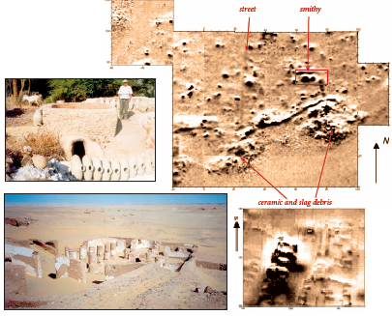
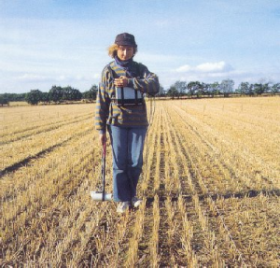
GEM Systems’ Equipment
Archaeology
Egypt.
Archaeologist Tatiana Smekalova
Notes:
10

Slide 11
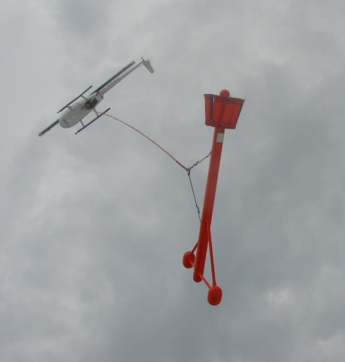
GEM Systems’ Equipment
Airborne and ground systems (mobile and stationary):
Proton magnetometers /
gradiometers
Overhauser magnetometers /
Gradiometers
Potassium magnetometers /
gradiometers
Notes:
11

Slide 12
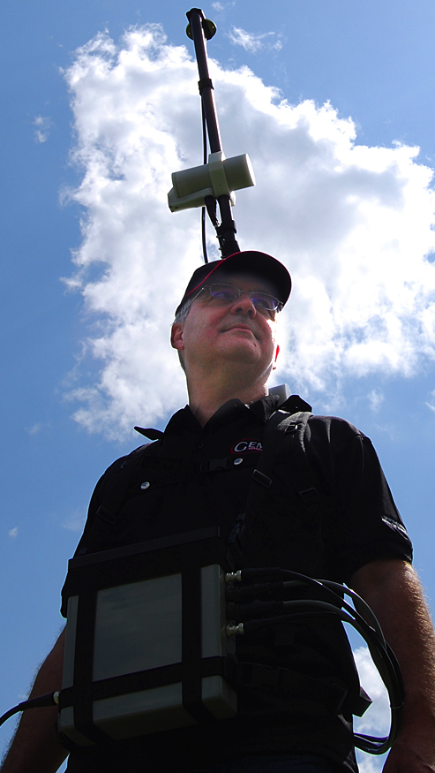
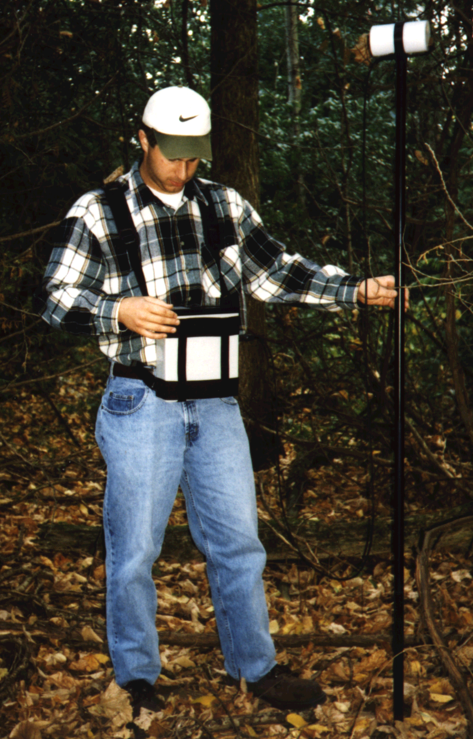
GEM Systems’ Equipment.
Walking Proton magnetometers / gradiometers
High sensitivity 0.15 nT @ 1 Hz
Memory for 5 million readings
Programmable base station (Daily and Flexible scheduling; Immediate start mode)
Notes:
12

Slide 13
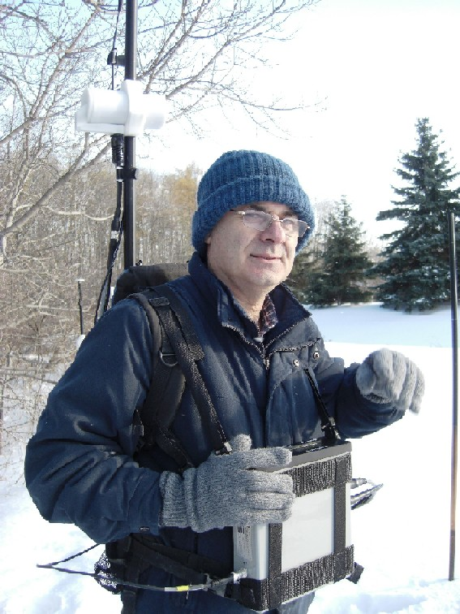
GEM Systems’ Equipment. Overhauser magnetometers / gradiometers
The new technology provides :
0.022 nT @ 1 Hz sensitivity
High gradient tolerance
Minimum heading errors
“Clean” geophysical signal
Ultra-fast operation
High absolute accuracy
Ability to combine magnetometer / gradiometer / VLF / GPS positioning
Notes:
13

Slide 14
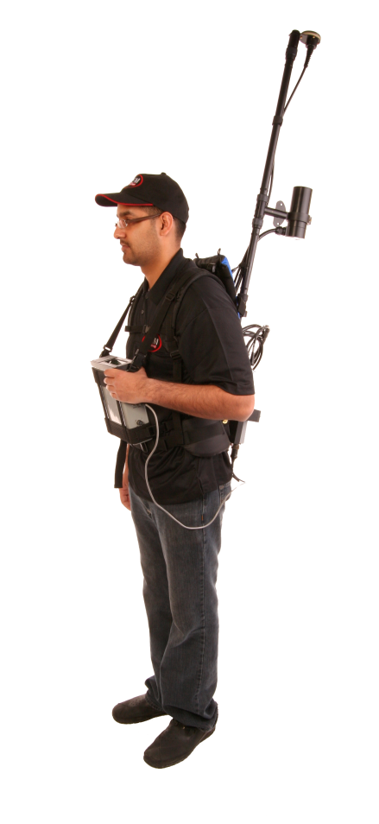
GSMP-35 Version 8.0 Potassium Magnetometers / Gradiometers for Ground Exploration
The best instrument for mapping of subtle geological signals
• Highest sensitivity at 0.0005 nT at 1 Hz
• Low power consumption up to 16 hours of continuous operation per charge
• Light weight and compact design
• Gradient tolerance 35,000 nT/m
• Fast sampling up to 20 Hz; Ideal high resolution surveys
• Integrated backpack: convenience and high productivity
• Proven reliability based on 28 years of R&D
Notes:
14

Slide 15
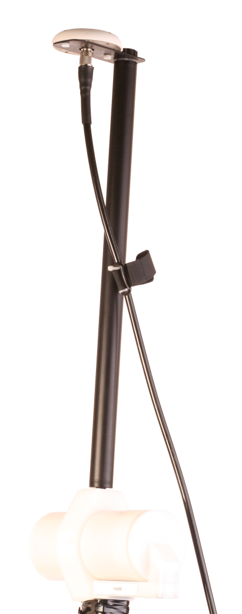
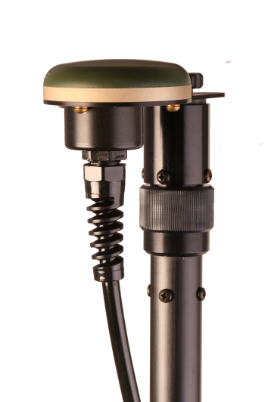
Global GPS Options
Enhanced GPS positioning resolution
Standard GPS: <0.7m
High resolution CDGPS Option:
<0.6m SBAS (WAAS, EGNOS, MSAS)
<0.6m OmniStar (VBS2 subscription)
Notes:
15

Slide 16
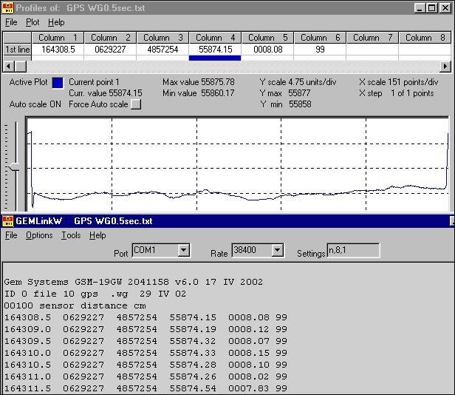
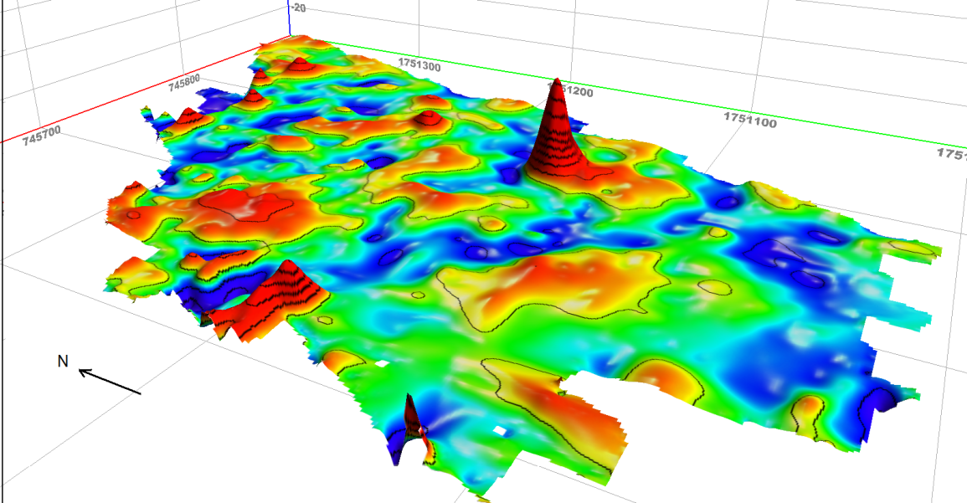
Software and Modeling
End-to-End solution for:
Transferring data rapidly to PC
Applying diurnal corrections
Visualizing data in 1D, 2D and 3D for quick quality control (QC)
And first-level analysis
Modeling single or
multiple anomalies for
Interpretation
3D graph using Encom PA Explorer
Notes:
16

Slide 17
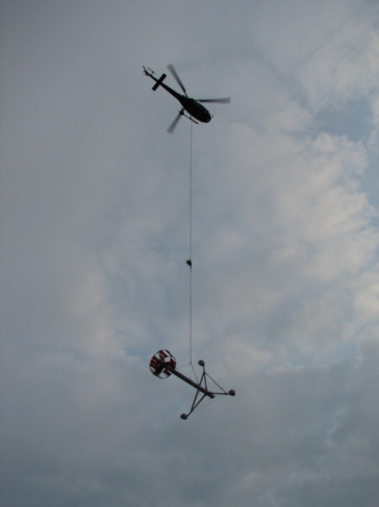
Conclusion
Magnetics represent one of the most effective exploration method globally outlining structure, geology and ore deposits.
GEM continues to deliver systems around the world with results that have led to Discover Gold in South Africa, Diamonds in Canada, Cooper in Chile and more.
GEM is a world leader in supplying the most advanced magnetometers, reliable, easy-to-use and accurate for projects in many different environments. Ground, Airborne and Base station units are available with the highest data quality and specifications in the market.
We offer proven results world wide.
Highest Sensitivity and Clean Data:
-GSMP-35 Potassium Magnetometer 0.0005 nT
-GSM-19W Overhauser Walking Magnetometer 0.022 nT
GEM Changing the Nature of Surveying
Notes:
17

Slide 18

Thank You!

